Slide 1
My survey
your opinion is important

Slide 2
According to statistics, 9 out of 10 startups fail. But why?
34% of startup failures are due to a poor product-market fit
no matter how good a product is,
people won't use it if they don't need it
so, before launching a product,
you need to find out if people need it
Statistics was taken from https://explodingtopics.com/blog/startup-failure-stats
2

Slide 3
How to know what do people want?
You can
But
conduct a survey
ask people about their problems
offer a product
use open and closed questions
how to find people?
how to understand if people are part of the target audience?
how to motivate people?
3

Slide 4
We introduce My survey
My survey is a cross-platform application for startups and users.
allows startups to
quickly find the target audience of their product
create personalized surveys and address them to other users
allows users to
earn money by completing surveys
get access to early versions of products
4

Slide 5


How does it work?
A startup
A user
compiles a survey
selects the target audience
deposit the amount
get people's opinions
fill in information about himself
take the suggested surveys
receive a little cash for each survey
withdraws money to the card
5

Slide 6
More about the implementation
cross-platform
desktop version
mobile app for IOS
mobile app for Android
functionality for startups
a convenient survey editor with a variety of question forms
detailed configuration of the target audience for each survey
functionality for users
single registration for all surveys
convenient division of surveys into categories and a filter
6

Slide 7
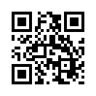
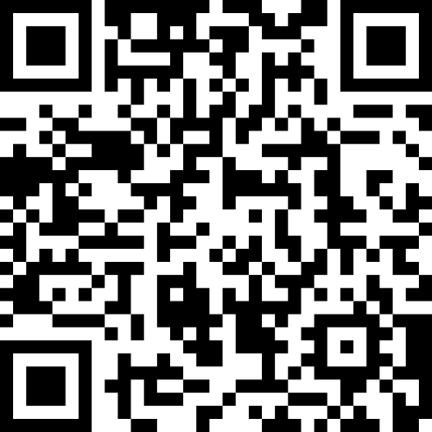
join the team
or
support

